Slide 1

WEB TECHNOLOGIES (UE19CS204)
MINI PROJECT

Slide 2
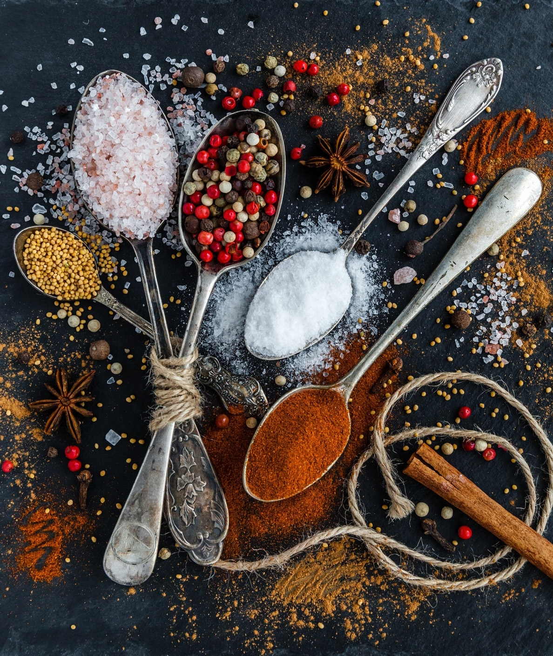
TITLE : FOODIE-GO SECTION : ‘H’
GITHUB LINK:
https://github.com/siddharthmagadum16/foodie-go
https://github.com/siddharthmagadum16/foodie-go-api
TEAM MEMBERS:
SIDDARTH VUPPUNAHALLI PES1UG19CS480
SIDDHARTH MAGADUM PES1UG19CS482
SIRI S PES1UG19CS485
SNEHA P PES1UG19CS490

Slide 3
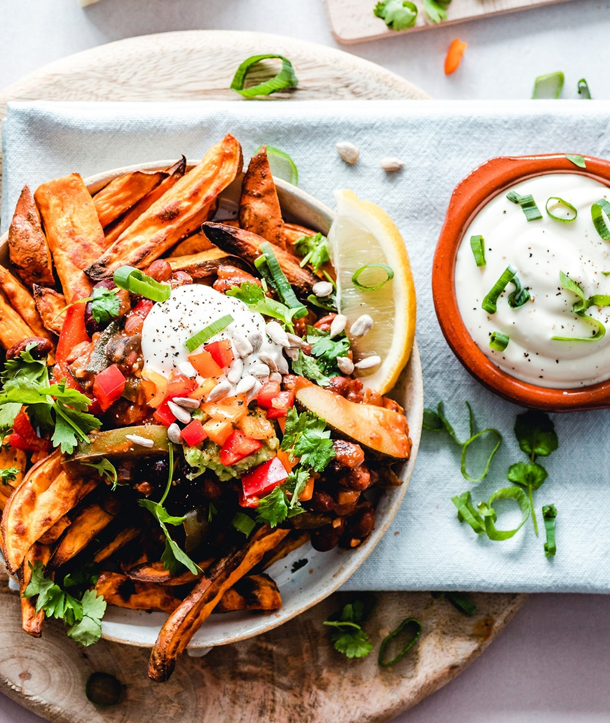
ABSTRACT:
Our website is designed for home cooks and food lovers. This website allows you to sell and buy food. A seller can put up his/her food product at their own price on the “sell” page. Once the description is put up, it appears on the “buy” page for people to view and contact the seller. For both these processes, a user is expected to sign in with a valid e-mail address and password.

Slide 4

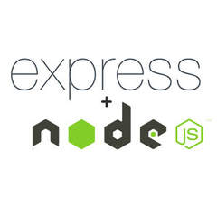

TECHNOLOGIES USED:
react-router-dom
axios
create-react-app
Express
body-parser
mongoose
Nodemon
Are the modules That were imported

Slide 5
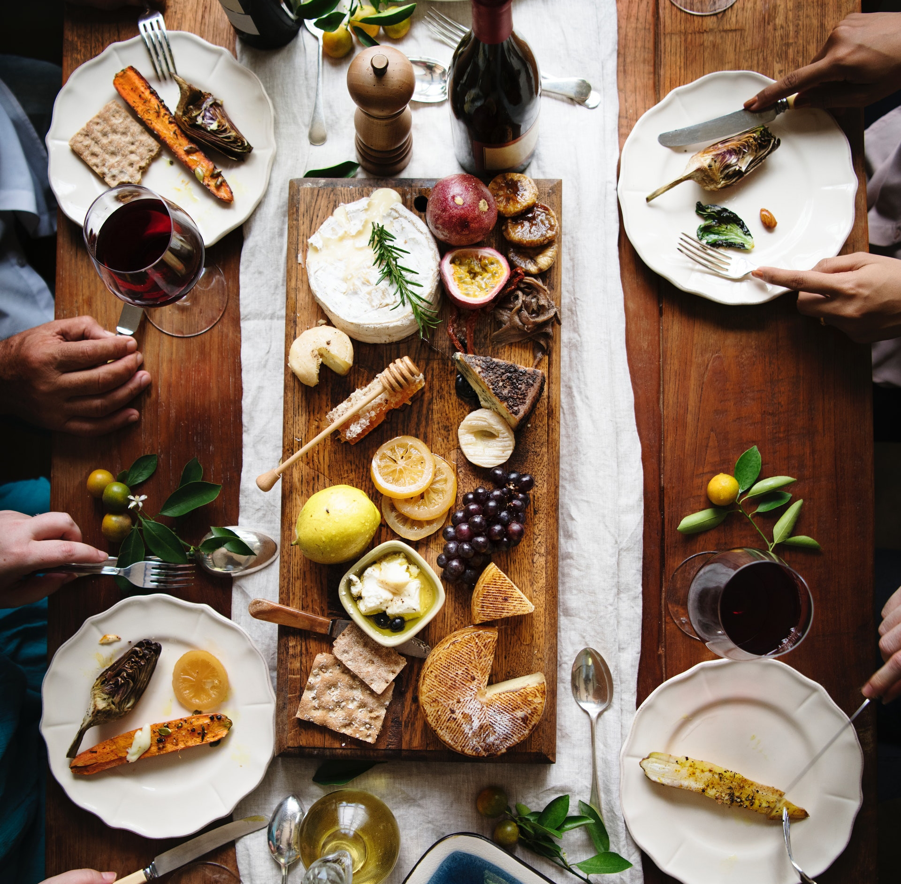
MEMBER CONTRIBUTIONS:
1. SIDDARTH VUPPUNAHALLI:
Worked on React, Node, CSS
2. SIDDHARTH MAGADUM:
Worked on React, Node, Express, MongoDB, CSS
3. SIRI S:
Worked on React, Node, CSS, Presentation
4. SNEHA P:
Worked on React, Express, CSS, Presentation

Slide 6
TOOLS USED FOR THE PROJECT:
Postman: Postman API testing , the most used requests are HTTP requests . Request URL - Also known as an endpoint, this is where API testing is done. Postman is one of the most popular tools used in API testing by sending requests to.
MongoDB Compass : the GUI for MongoDB, is the easiest way to explore and manipulate your data MongoDB Compass analyzes the documents and displays rich structures within Compass in MongoDB 3.4 is excellent. We get a fast overview of your data's behavior.

Slide 7

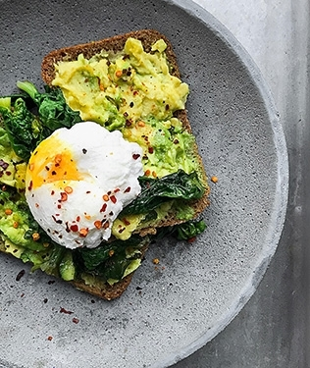
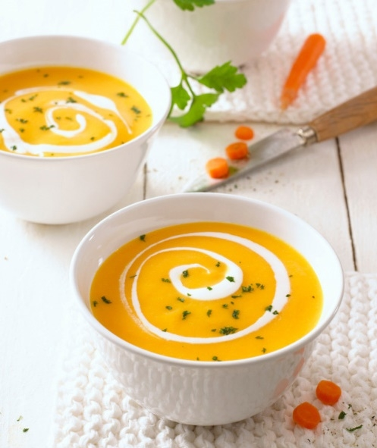
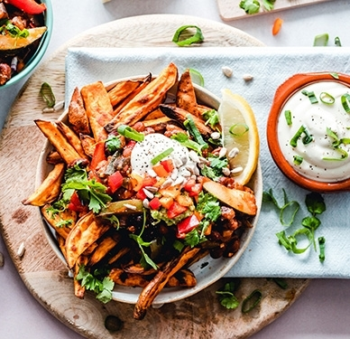

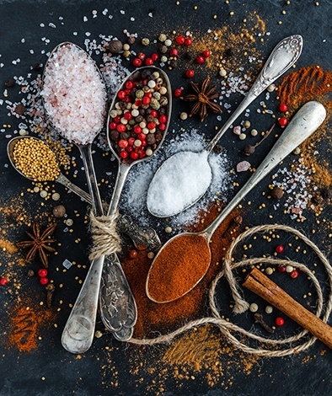

Title Here

